Slide 1

Amazon
Elastic Compute Cloud
(Amazon EC2)

Slide 2
On-Demand Instances
Pay as you go pricing model
No contracts
Great for:
Workload uncertainty
Commitment free usage
Experimentation
The flexibility comes at a higher cost

Slide 3
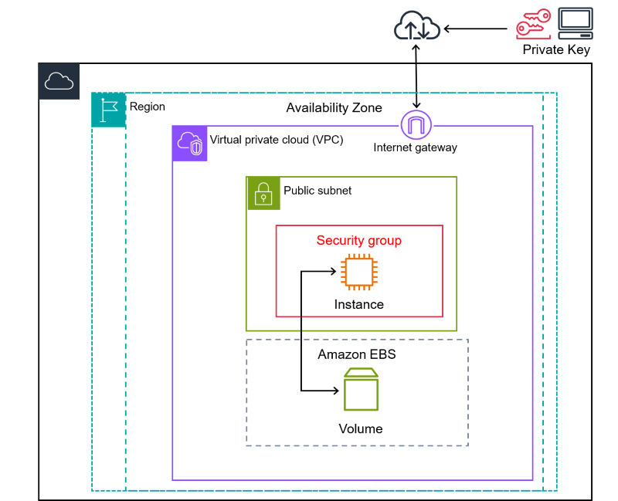
What is Amazon EC2?
Amazon Elastic Compute Cloud (Amazon EC2) provides on-demand, scalable computing capacity in the Amazon Web Services (AWS) Cloud.
VM on Cloud
Using Amazon EC2 reduces hardware costs so you can develop and deploy applications faster.
➔ Virtual hardware & software
You can use Amazon EC2 to launch as many or as few virtual servers as you need, configure security and networking, and manage storage.
➔ Virtual OS & application

Slide 4
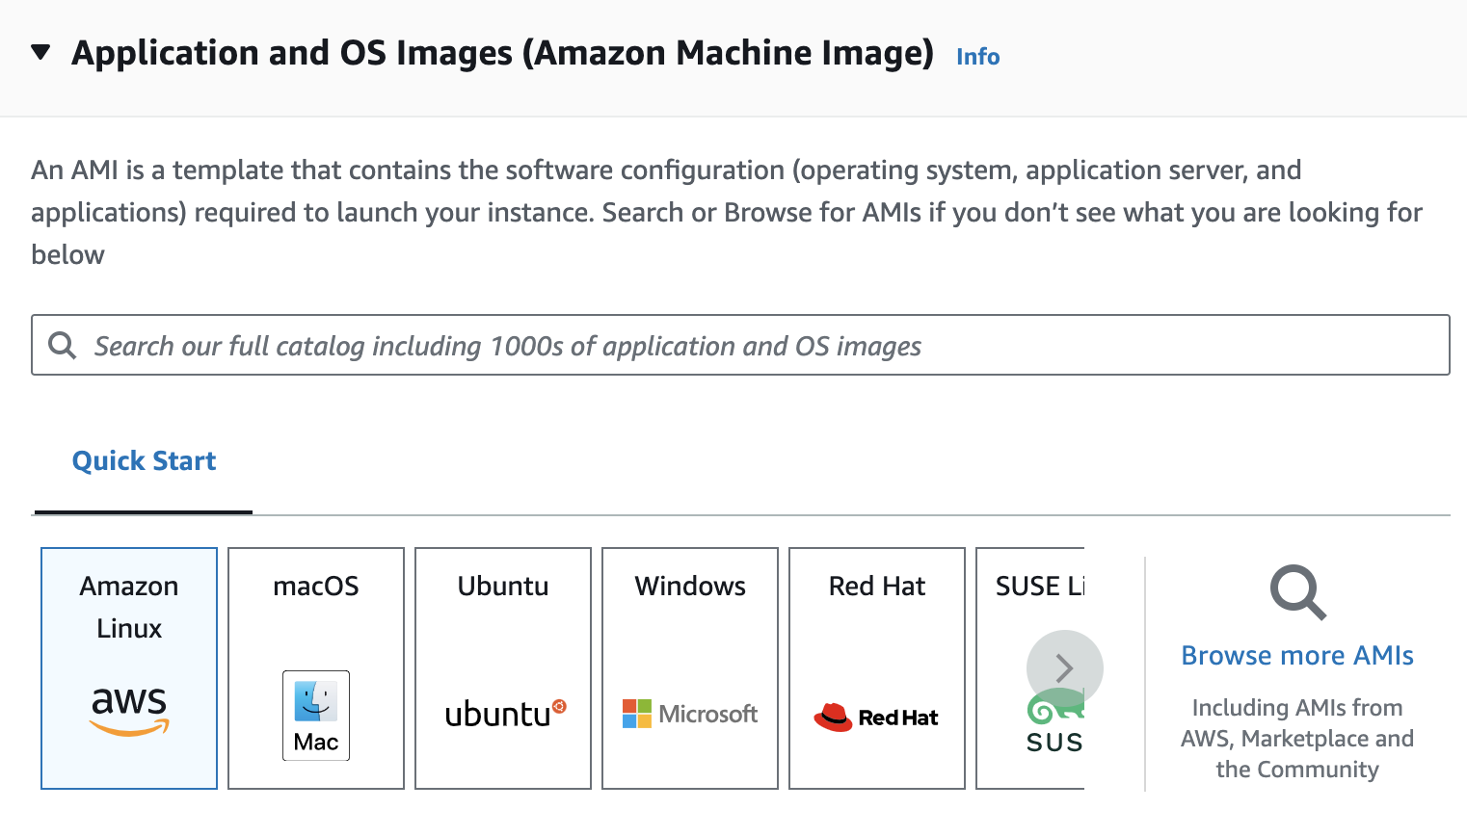


Commonly Used OS

Slide 5
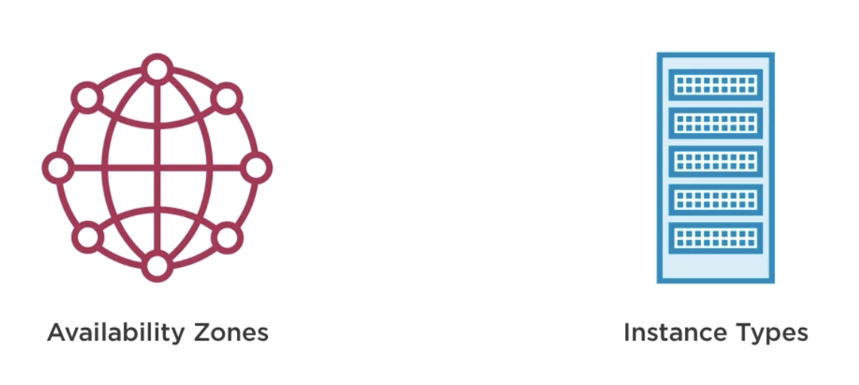
Key Concepts

Slide 6
Availability Zones
“AWS has the concept of a Region, which is a physical location around the world where we cluster data centers. We call each group of logical data centers an Availability Zone.
Each AWS Region consists of multiple, isolated, and physically separate AZs within a geographic area.
Each AZ has independent power, cooling, and physical security and is connected via redundant, ultra-low-latency networks.”
By AWS
https://infrastructure.aws/
Notes:
Unlike other cloud providers, who often define a region as a single data center, the multiple AZ design of every AWS Region offers advantages for customers.

Slide 7
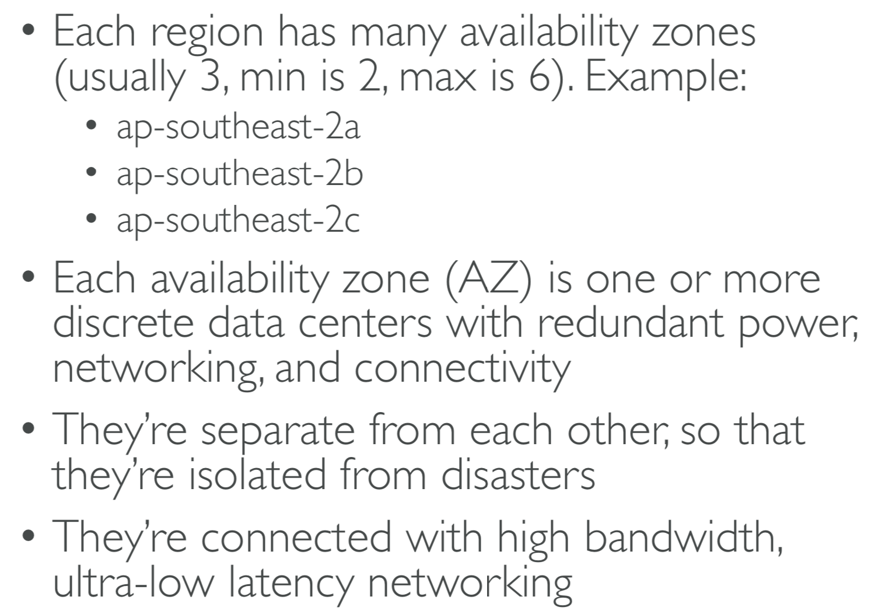
Availability Zones
Notes:
EC2(to2:10): https://www.linkedin.com/learning/aws-essential-training-for-developers/birth-of-the-cloud-ec2-and-s3
AZ: https://www.linkedin.com/learning/aws-essential-training-for-developers/regions-and-availability-zones

Slide 8
Instance Types
Allow you to specify the hardware of the host computer to accommodate your application’s needs

Slide 9
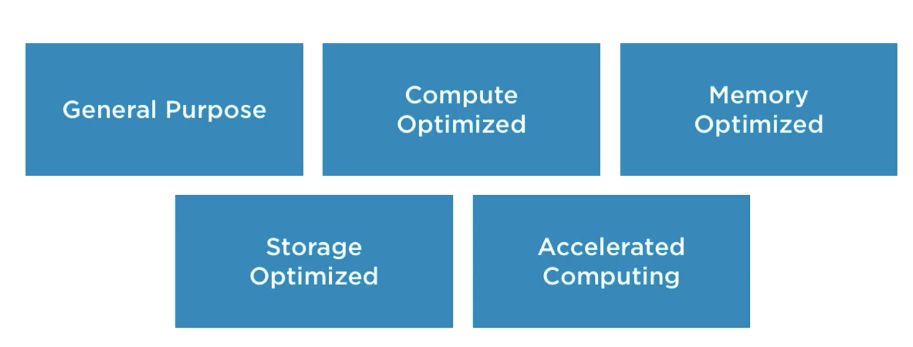
Instance Families

Slide 10
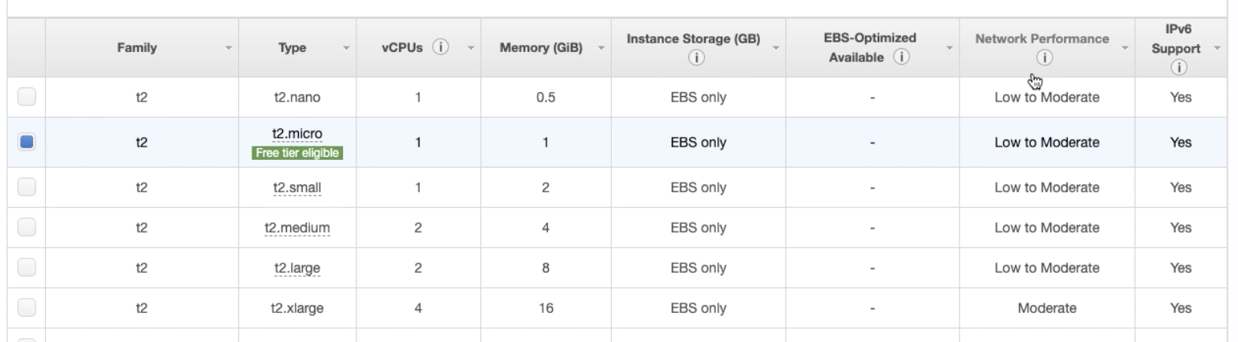
Instance Sizes
Note: we will use t3.micro, since t2 family is not available under free plan

Slide 11
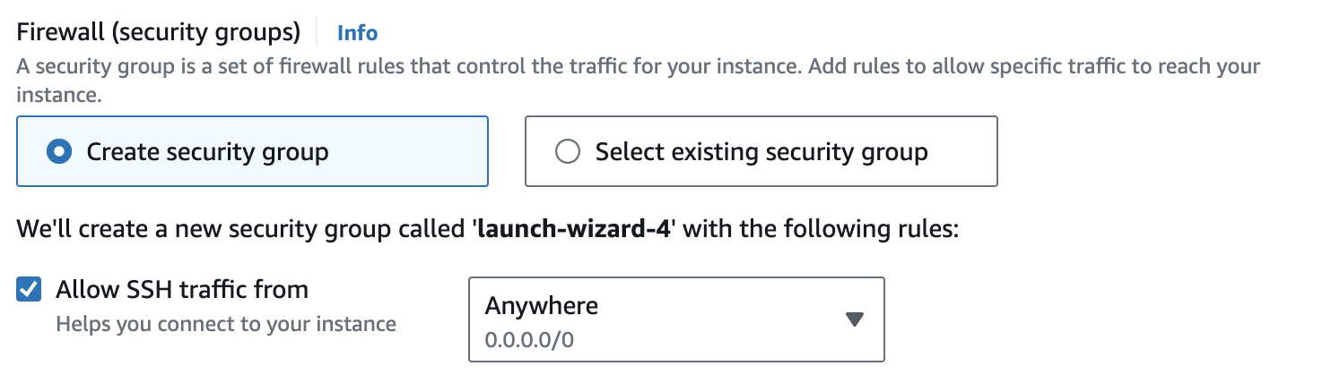
Connect To EC2 Linux instance
SSH ➔ Linux, so security group need to enable SSH
If you are on a MacOS or Linux, just use Terminal or shell
If you are on a Windows, need to install git-shell to have a Linux shell

Slide 12
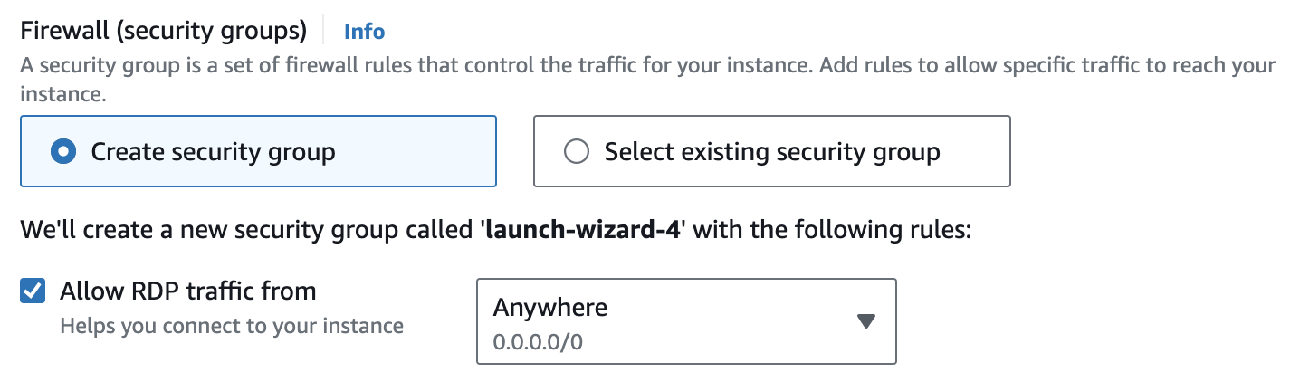
Connect To EC2 Windows instance
RDP ➔ Windows, so security group need to enable RDP
Need to install an RDP client: (Ref: here)
[Windows] Windows includes an RDP client by default. To verify, type mstsc at a Command Prompt window. If your computer doesn't recognize this command, see the Windows home page and search for the download for the Microsoft Remote Desktop app.
[Mac OS X] Download the Microsoft Remote Desktop app from the Mac App Store.
[Linux] Use Remmina.

Slide 13
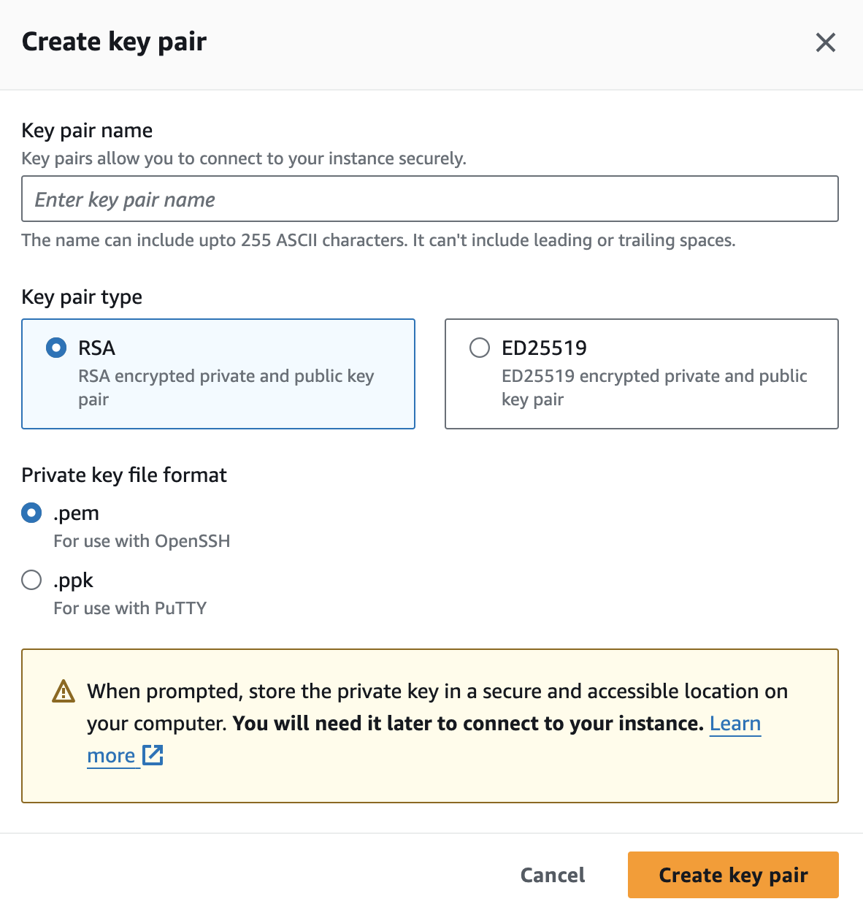
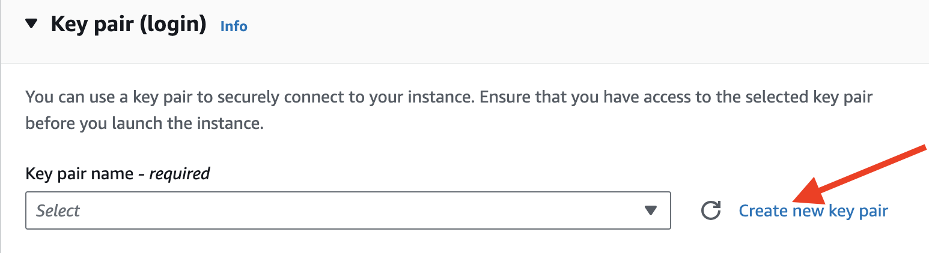
Key pair (login)
(Encrypted credentials)
How to use .pem file?
SSH to Linux: put .pem file in the working folder
RDP to Windows: decrypt .pem file to get a password

Slide 14
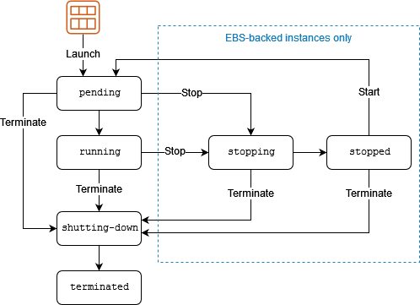
EC2 Instance Lifecycle
An Amazon EC2 instance transitions through different states from the moment you launch it through to its termination.
Read more here

Slide 15
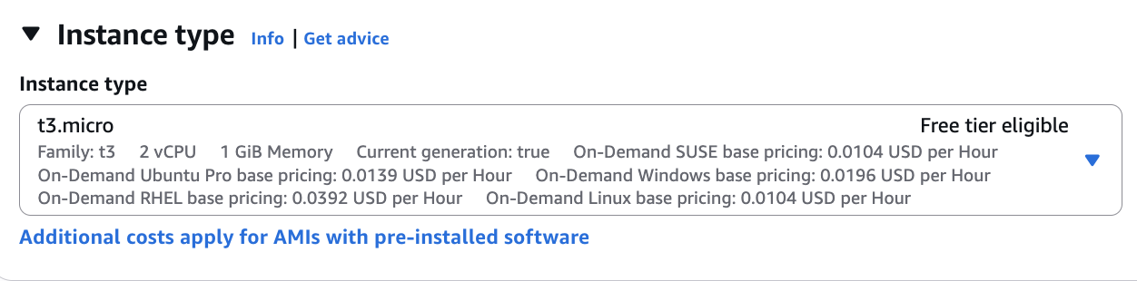
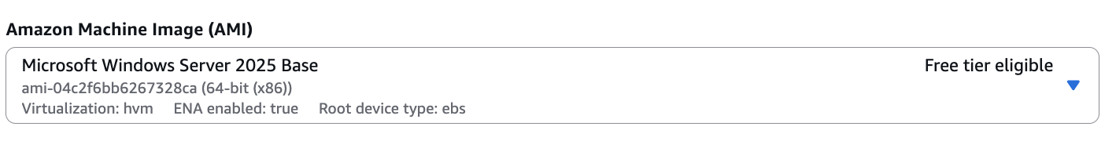
Free Tier Eligible

Slide 16

Lab Time

